Slide 1
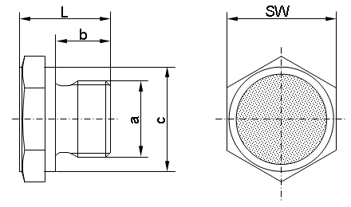
HAENCHEN
Technical data
BSP thread type | article no. | Metric thread type | article no. | b | c | L | Wrench size | Airflow rate in [l/min] at dp=0,25 bar
G 1/8 | 0300700A | M10x1 | 0301300A | 8 | 14 | 18 | 17 | 50
G 1/4 | 0300800A | M12x1,5* | 0301400A | 10 | 19/17* | 18 | 22 | 100
G 3/8 | 0300900A | M18x1,5 | 0301500A | 12 | 23 | 20 | 24 | 130
G 1/2 | 0301000A | M22x1,5 | 0301600A | 14 | 26 | 23 | 27 | 160
G 3/4 | 0301100A | M27x2 | 0301700A | 16 | 32 | 25 | 32 | 220
G 1 | 0301200A | M33x2 | 0301800A | 18 | 39 | 30 | 41 | 400

